Slide 1







Heart Attack
Analysis & Prediction
Save your Heart

Slide 2



Agenda
Domain knowledge
Understanding the problem and what is Heart attack - Symptoms & Risk factors
Data Preparation
Reading the Data, understanding it and do preprocssing.
Modling
bulid the model
Results and Conclusion
draw conclusion and deploy the model

Slide 3


Domain knowledge
A heart attack, or myocardial infarction, occurs when the flow of oxygen-rich blood to a part of the heart muscle becomes blocked. This is a medical emergency that can result in death or damage to the heart muscle if not treated promptly.

Slide 4


Symptoms & Risk factors
Symptoms
Risk factors
Chest pain
Pain or discomfort
Cold sweat
Fatigue
Heartburn or indigestion
Lightheadedness or sudden dizziness
Nausea
Shortness of breath
Age
Tobacco use
High blood pressure
High cholesterol or triglycerides
Obesity
Family history of heart attacks
Stress

Slide 5
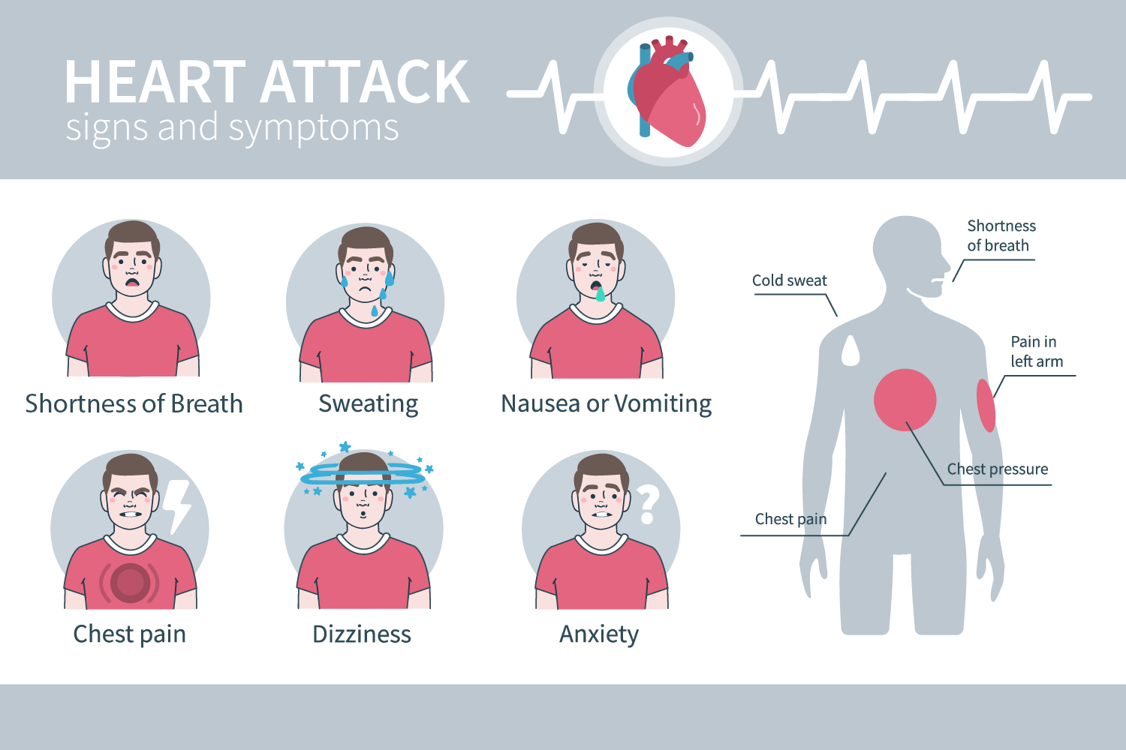

Slide 6
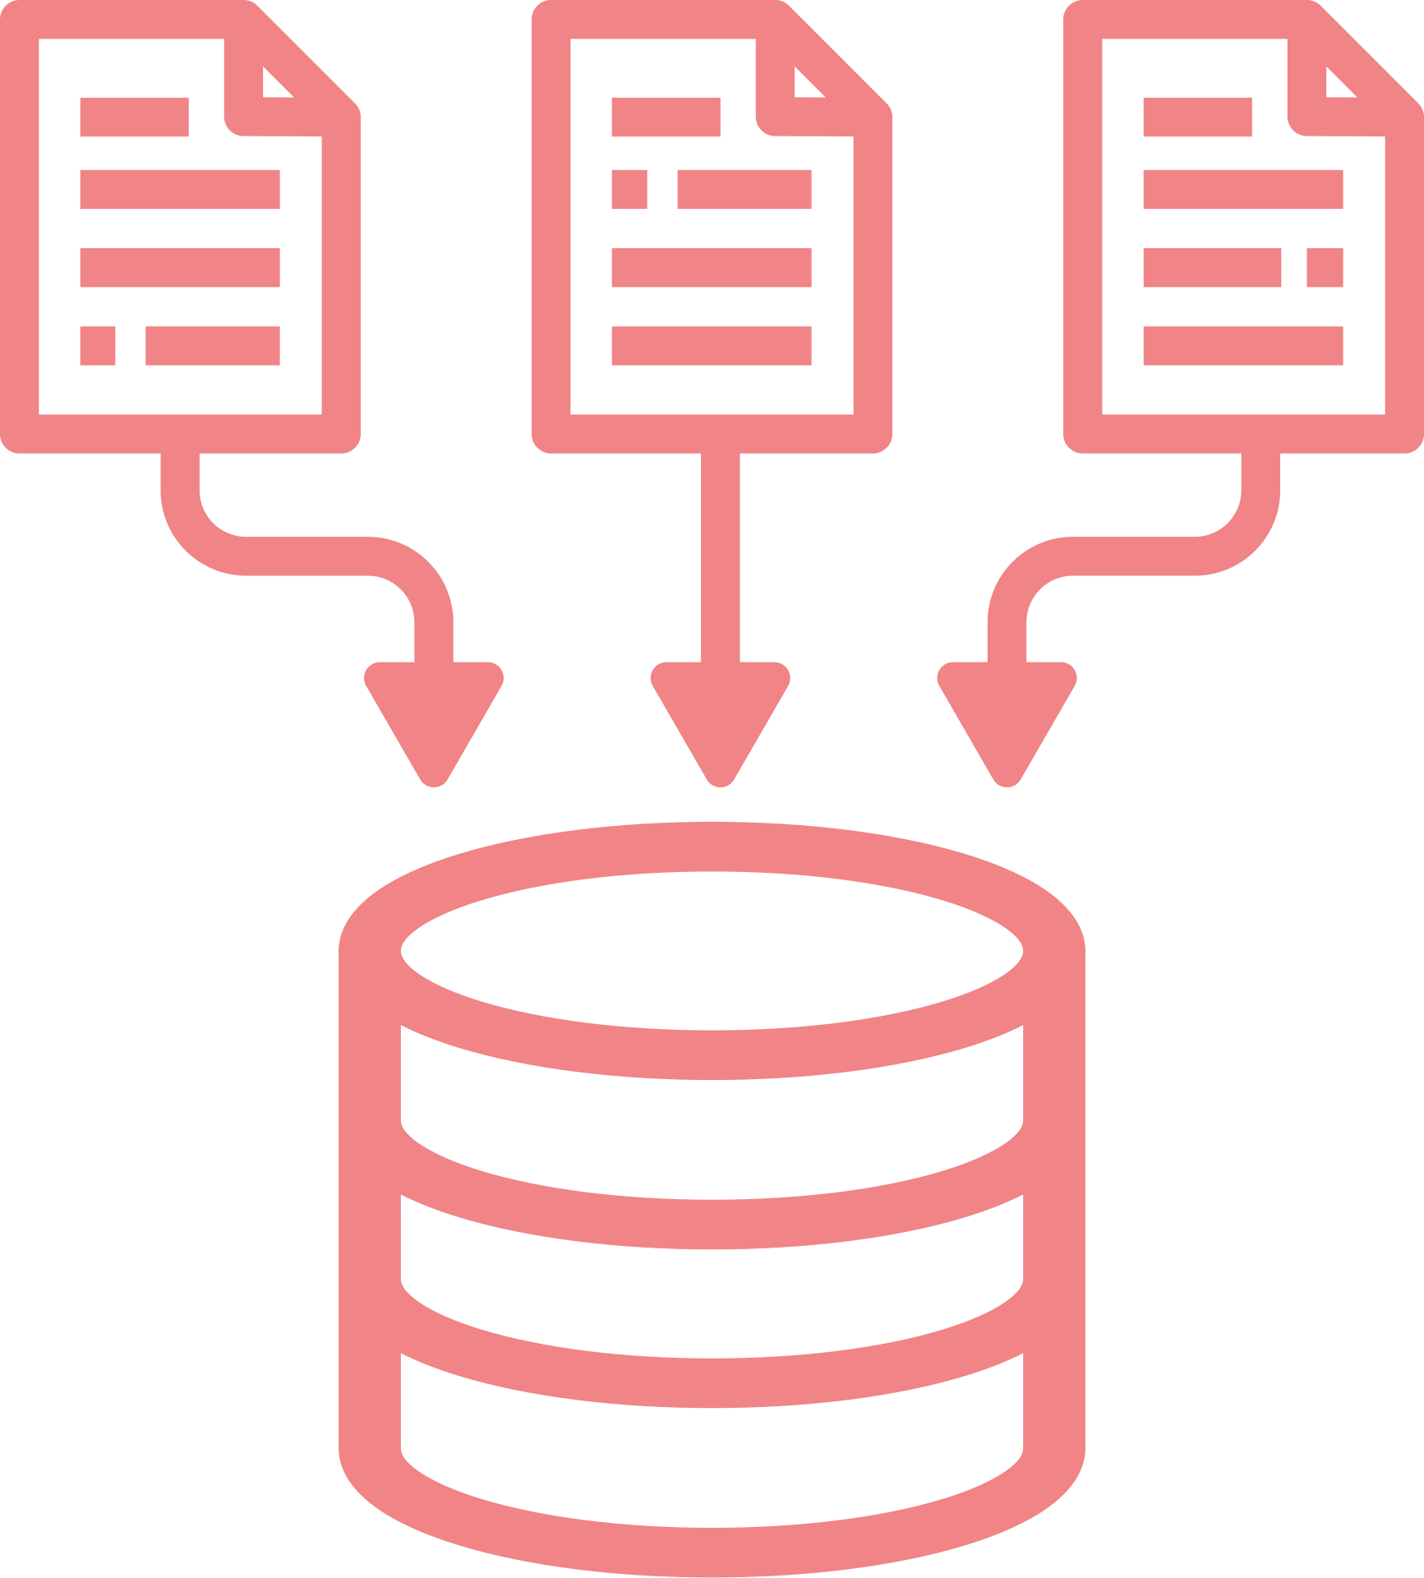



Data Prepration
Reading
Cleaning
EDA
preprocessing

Slide 7


Modling
SVC
CalibratedClassifierCV(SVC)
LinearSVC
Decision Tree Classifier
Random Forest Classifier
accuracy
classification_report
XGBClassifier

Slide 8


Results and Conclusion
Overall, CalibratedClassifierCV with SVC algorithm is the most suitable model for this heart attack prediction task, providing the best balance between accuracy, precision, and recall. This model can reliably predict heart attack occurrences and is recommended for further refinement and deployment. Models like Linear Regression, SVC, Linear SVC, and neural networks can obtain a high accuracy also, but it is not high compared to the CalibratedClassifierCV. Also, some models seem to be overfitted such as Decision Tree, Random Forest, and XGBClassifier means this type of problem needs a simpler model (linear models are more suitable).

Slide 9
Deploy the model using Streamlit
1
Export the model as pickle file
2
build the app using streamlit
App link: https://heartattackclassificationdash-cesztsfiex35uwhwvgxkka.streamlit.app/

Slide 10

1
Amina Younis
Team
Members
2
Ahmed Samih
3
Mohamed Motaz
4
Rehab Hashim
5
Adham Abdelwadoud

Slide 11



Thank You

